Slide 1
Foreclosures, Unemployment and Crime Rate
Lixin Tian
Shubhangi K
Reena Patel
Joseph Kunz
Raj Shah

Slide 2
The Question…
Do foreclosures cause crime and affect unemployment rate in Los Angeles City?
Notes:
Related research has reported subjective evidence suggesting that foreclosed properties attract vandalism, trespassing, prostitutes, drug related crime, squatters and copper thieves.
However research to support those claims has been lacking, and disagreement continues about whether foreclosures and bank-owned properties increase neighborhood crime in Los Angeles City.

Slide 3
Questions raised?
Link between foreclosure and crime by comparing crime in areas with foreclosure properties to crime in areas without foreclosure properties
How does foreclosures affect unemployment rate?
What types of crimes are more sensitive to foreclosures?
Is there a threshold level of foreclosures that triggers crime?
Notes:
Crime may increase as local residents are less able to recognize outsiders and to maintain the effective social controls

Slide 4
Data Sources
Crime Data: (Add data source link)
Crimes reported in Los Angeles City between 2016 and 2019.
Dataset includes the spatial coordinates of each reported crime, along with its date, time, and offense categories.
Foreclosure Data:(Add data source link)
Foreclosure reported in Los Angeles City between 2016 and 2019.
Dataset contains each reported foreclosures, along with its reported date, property type, location and lender information.
Unemployment Data: (Add data source link)
Los Angeles City Unemployment Rate between 2016 and 2019.
Dataset contains Los Angeles City Unemployment Rate for each year.
Notes:
Crime Data: We have found data on all crimes reported in Los Angeles City between 2016 and 2019. This detailed dataset includes the spatial coordinates of each reported crime, along with its date, time, and offense categories.
Crime Data Source:
Foreclosure Data: We used data on all foreclosure reported in Los Angeles City between 2016 and 2019. This comprehensive dataset contains each reported foreclosures, along with its reported date, property type, location and lender information.
Foreclosure Data Source:

Slide 5
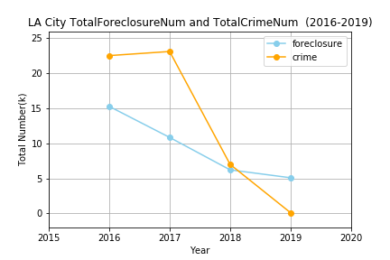
Foreclosures Vs Crime (YOY 2016 – 2019)

Slide 6
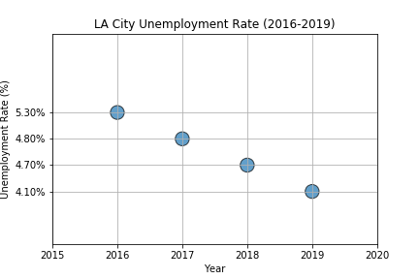
YOY Unemployment Rate (YOY 2016 – 2019)

Slide 7
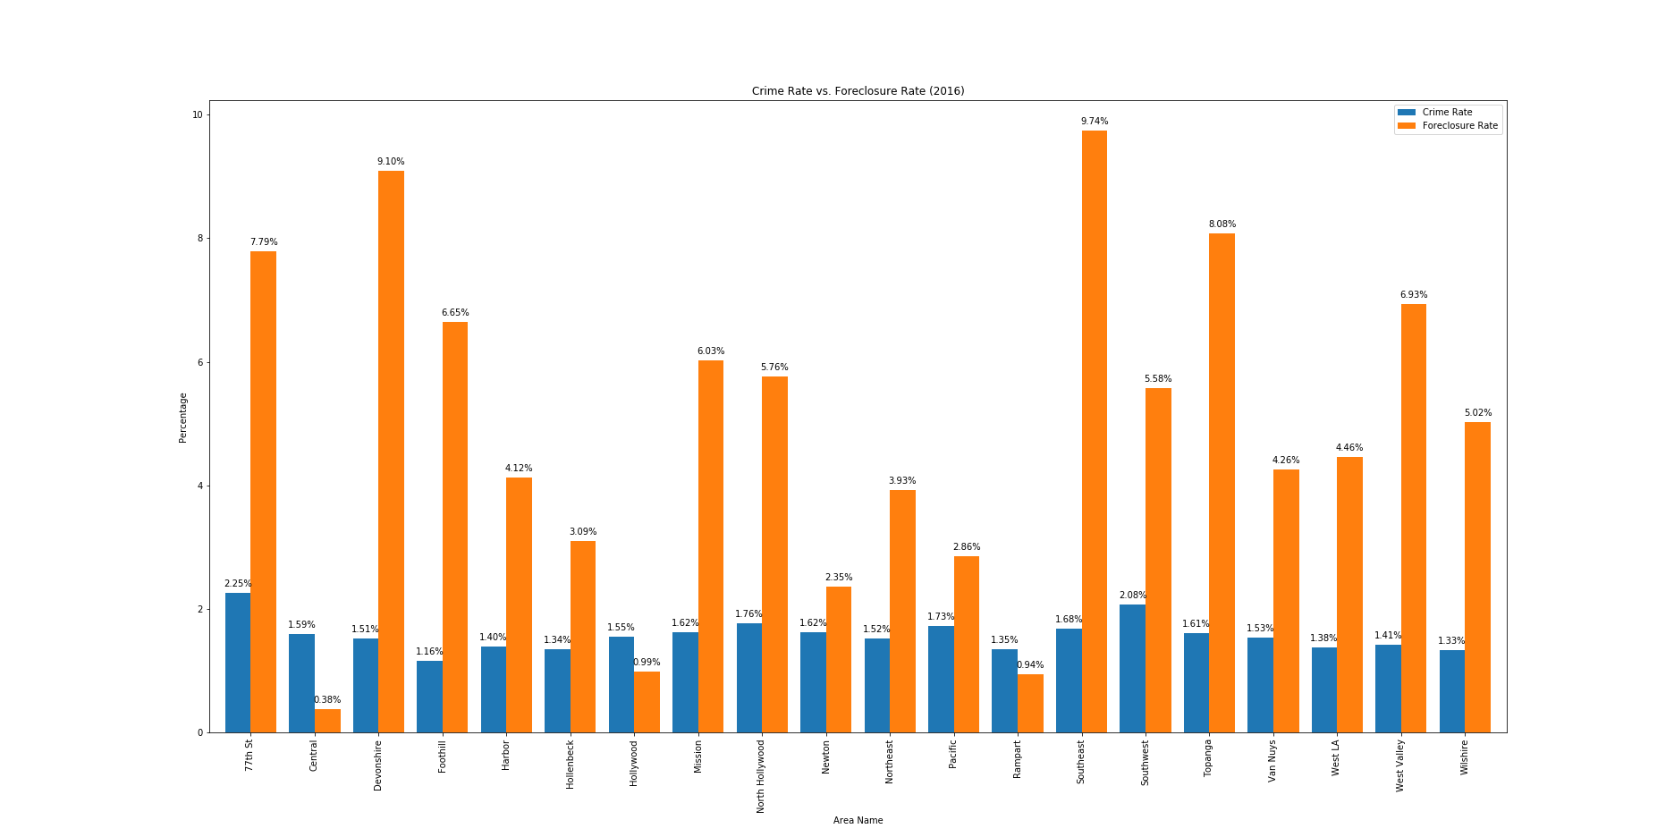
Top Crimes in foreclosure zones (2016)

Slide 8
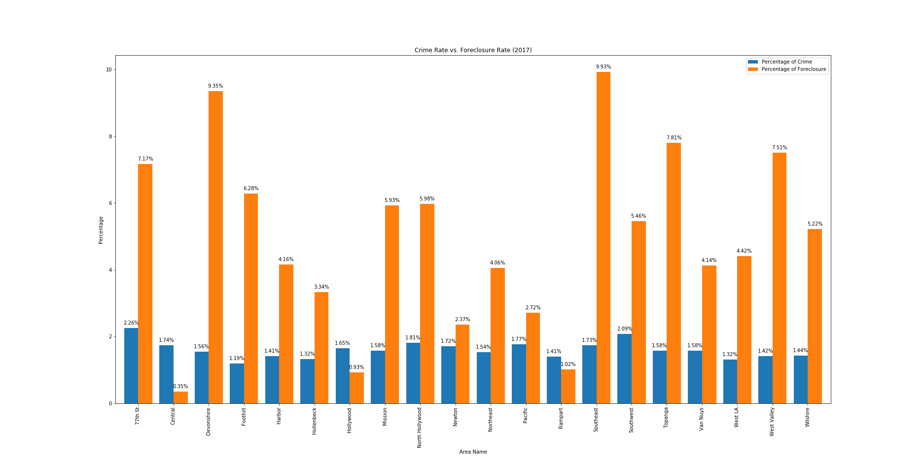
Top Crimes in foreclosure zones (2017)

Slide 9
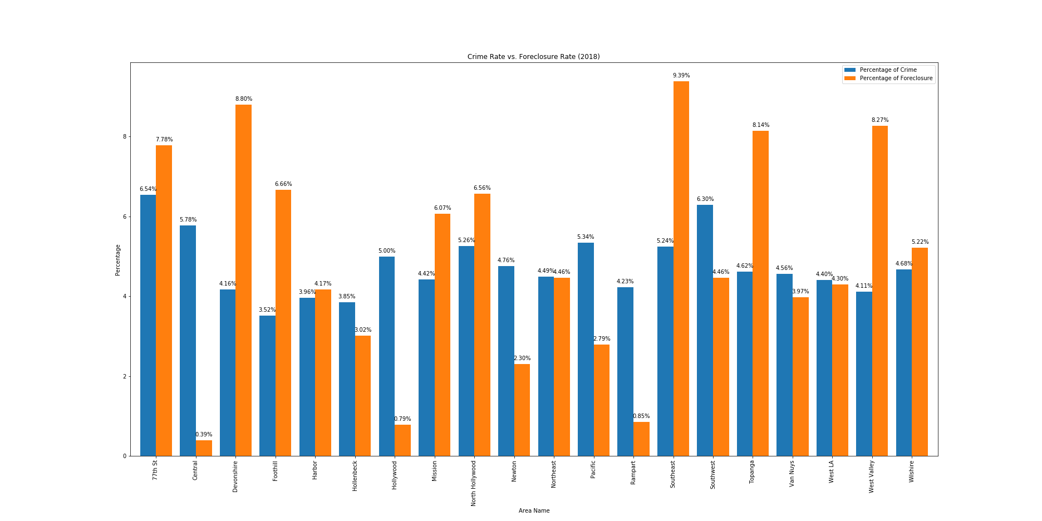
Top Crimes in foreclosure zones (2018)

Slide 10
Data Cleanup and exploration
Cleaning up with pandas:
Create consolidated report of 2016-2019 Crime and Foreclosure
Extract 2016-2019 Unemployment data for Los Angeles city
Add Zip code column using latitude and longitude information in crime data (Used google API)
Merge Crime data and Foreclosure data using Zip code column and removed unnecessary columns.
Notes:
Discuss the steps you took to analyze the data and answer each question you asked in your proposal

Slide 11
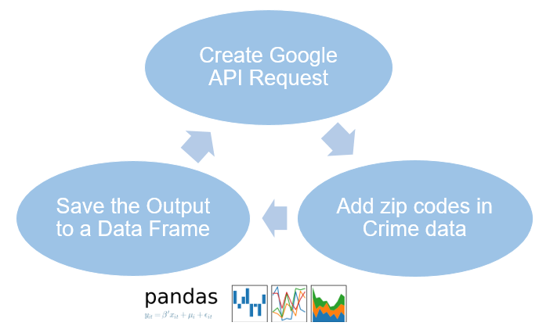
Data Retrieval: Google API to add area zip codes in crime data
Notes:
* Discuss the steps you took to analyze the data and answer each question you asked in your proposal

Slide 12
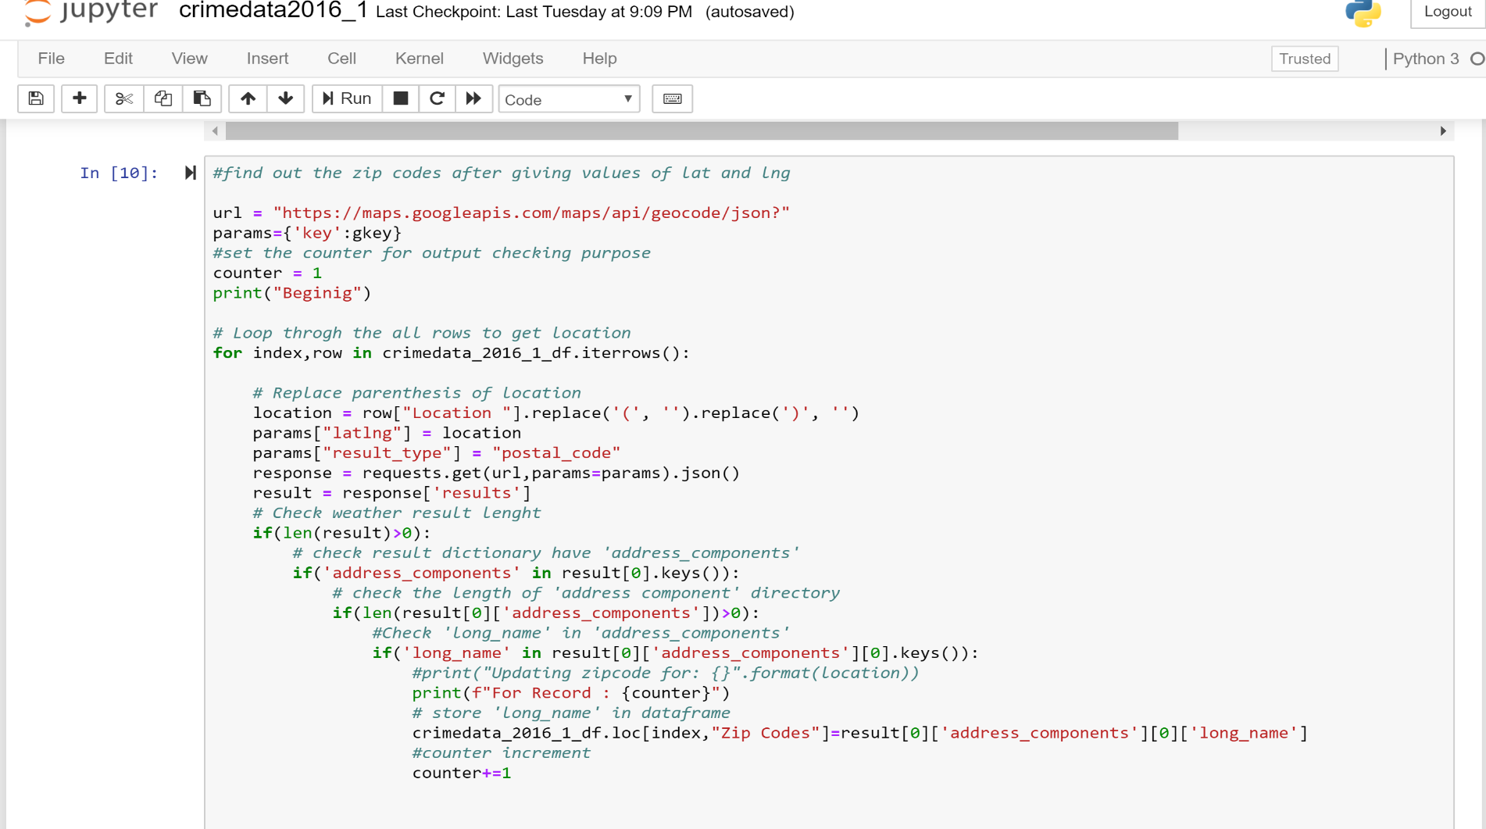
Data Retrieval: Google API to add area zip codes in crime data
Notes:
* Discuss the steps you took to analyze the data and answer each question you asked in your proposal

Slide 13
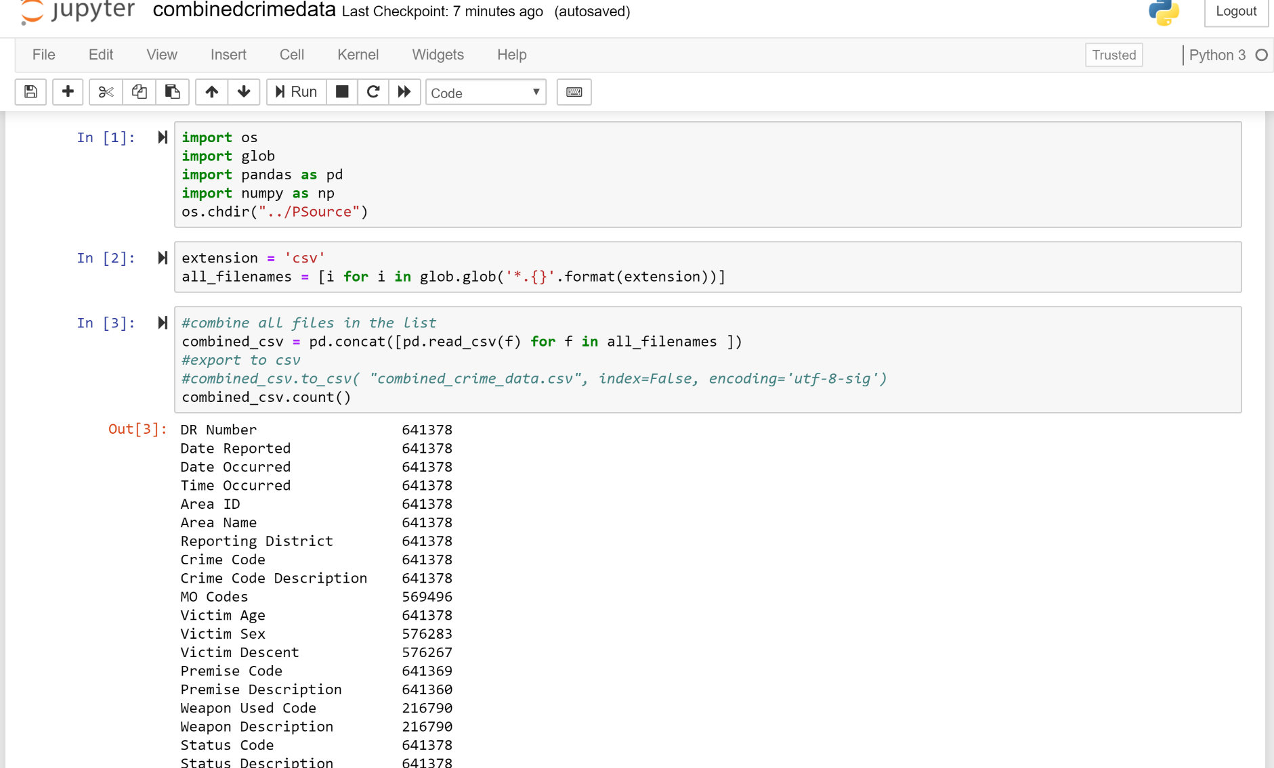
Data Retrieval: Merged Crime and Foreclosure Data
Notes:
* Discuss the steps you took to analyze the data and answer each question you asked in your proposal

Slide 14
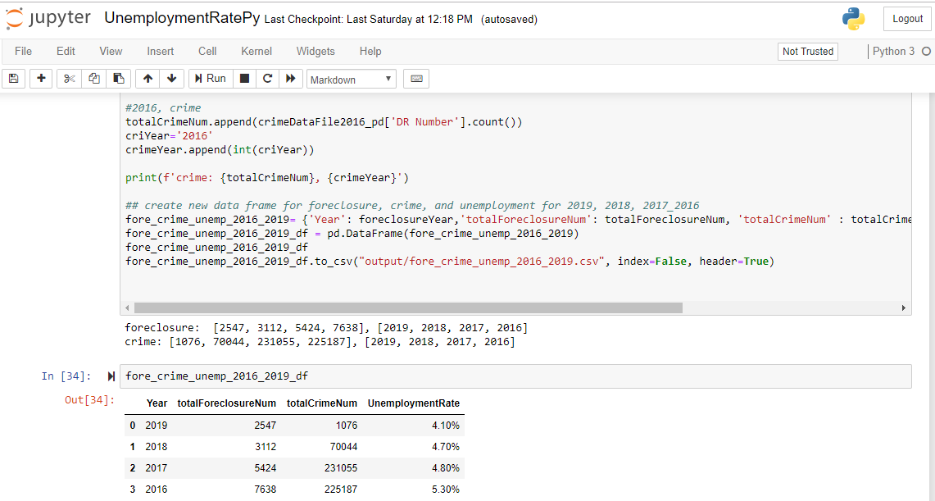
Analyze for Trends (Table)
Notes:
* Discuss the steps you took to analyze the data and answer each question you asked in your proposal

Slide 15
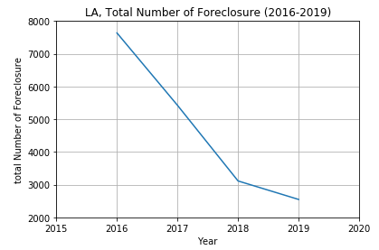
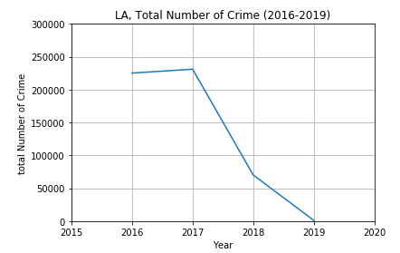
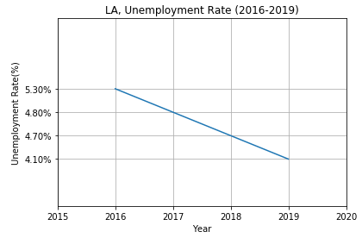
Conclusion
Notes:
* Discuss the steps you took to analyze the data and answer each question you asked in your proposal

Slide 16
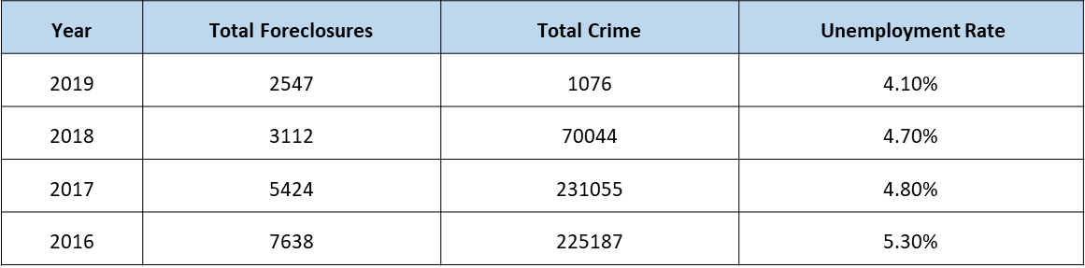
Conclusion
Based on our analysis, we do observe a small but significant positive “net” effect of foreclosure rates in 2017-2018. In particular, by analyzing each year separately, we show that neighborhood foreclosure is significantly associated with crime in a small number of selected areas; in the majority of the areas considered, foreclosure did not exert a significant main effect on either crime type. However, it is clear that decrease in foreclosures have a causal effect on unemployment.
Notes:
* Discuss the steps you took to analyze the data and answer each question you asked in your proposal

Slide 17
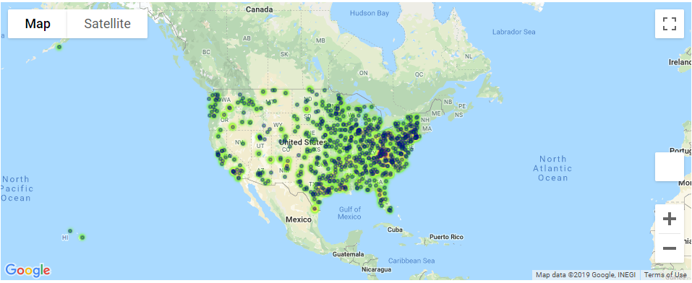
if we had two more weeks, we would have researched….
Notes:
Discuss any difficulties that arose, and how you dealt with them
* Discuss any additional questions that came up, but which you didn't have time to answer: What would you research next, if you had two more weeks?

Slide 18
Limitations in Analysis
We just had access to foreclosure filings or notices data, however if we were able to track foreclosure filings from initiation to resolution that would allows us to better understand how foreclosures resulting in different outcomes affect crime.
We could have find out if impacts on crime vary depending on the outcomes of the foreclosures.
Notes:
Discuss insights you had while exploring the data that you didn't anticipate

Slide 19
Questions…
Q&A

